Slide 1

Natural Language Processing
Recitation Class

Slide 2
Recap
Language Model: A system that predicts the next word
Recurrent Neural Network: A family of neural networks that:
Take sequential input of any length
Apply the same weights on each step.
Can optionally produce output on each step
Problems: Vanishing and exploding gradient
LSTM: Solution of Vanishing gradient
Gradient Clipping: Solution for Exploiding gradient
GRUs are similar to Long Short-Term Memory (LSTM)
Machine Translation
Seq Seq Neural machine translaton

Slide 3
So, is Machine Translation solved?
Nope! • Many difficulties remain: • Out-of-vocabulary words • Domain mismatch between train and test data • Maintaining context over longer text • Low-resource language pairs • Failures to accurately capture sentence meaning • Pronoun (or zero pronoun) resolution errors • Morphological agreement errors

Slide 4
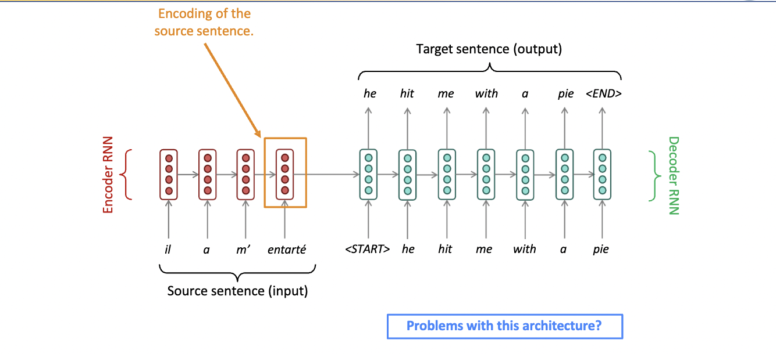
Seq to seq: Bottleneck Problem

Slide 5
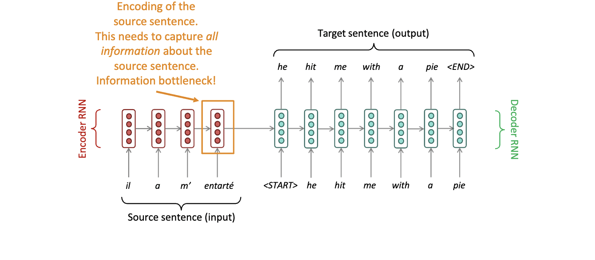
Seq to seq: Bottleneck Problem

Slide 6
Lets explain this problem in detail:
Encoding the Source Sequence: In a typical seq2seq model, the source sequence (e.g., a sentence in one language) is passed through an encoder, which processes the input one token at a time and produces a fixed-size representation (often called the context vector or hidden state) that should contain all the information needed for translation. This representation is typically a fixed-size vector, say, 512 dimensions.
Decoding and Generating the Target Sequence: The context vector is then used as the initial state for the decoder, which generates the target sequence (e.g., a sentence in another language) one token at a time. The decoder should use the context vector to capture the semantics, context, and structure of the source sentence to produce an accurate translation.

Slide 7
Bottleneck Problem:
The bottleneck problem arises from the fixed-size representation of the source sentence. If the source sentence is very long or contains complex information, it's challenging for the encoder to compress all the relevant information into this fixed-size vector. As a result, some information may be lost or not adequately represented in the context vector.

Slide 8
Lets take example:
Context and Task: Suppose you are working on a machine translation task, translating a comprehensive scientific research paper from English to Japanese.
Source Sentence (English): "The study examines the interplay between quantum entanglement and black hole thermodynamics, shedding light on the nature of spacetime."
Complex Concepts: In this sentence, there are several complex scientific concepts, such as "quantum entanglement" and "black hole thermodynamics," which may not have direct equivalents in Japanese.

Slide 9
Continuation:
Importance of Accurate Translation: It's critical to accurately translate these complex scientific concepts to ensure that the essence of the research is preserved.
The Bottleneck Problem: However, when using a sequence-to-sequence NMT model with a fixed-size representation in the encoder, it may struggle to capture the intricate scientific nuances effectively.
Impact on Translation Quality: This limitation can result in a less precise translation, potentially leading to a loss of critical scientific details. As a result, the Japanese audience may have difficulty understanding the intricate connection between quantum physics and black hole thermodynamics, which is crucial to the research.

Slide 10

Solution to Bottleneck problem?
Attention provides a solution to the bottleneck problem. • Core idea: on each step of the decoder, use direct connection to the encoder to focus on a particular part of the source sequence

Slide 11
The Attention Process:
Step 1: Compute Attention Scores:
The decoder's current hidden state and all encoder hidden states are used to calculate attention scores.
Attention scores measure how well each encoder state aligns with the current decoder state.
Step 2: Softmax for Attention Distribution:
The attention scores are normalized using the softmax function, resulting in an attention distribution.
The attention distribution represents the relative importance of each encoder state for the current decoding step.

Slide 12
Continued:
Step 3: Calculate the Context Vector (Attention Output):
The context vector, also known as the attention output, is obtained by taking a weighted sum of the encoder hidden states using the attention distribution.
The context vector captures information from the input sequence relevant to the current decoding step.
Step 4: Augment Decoder Input:
The context vector is concatenated with the decoder's current hidden state to form the input for generating the current output element.
This augmented input takes into account both the current decoder state and the relevant information from the input sequence.

Slide 13
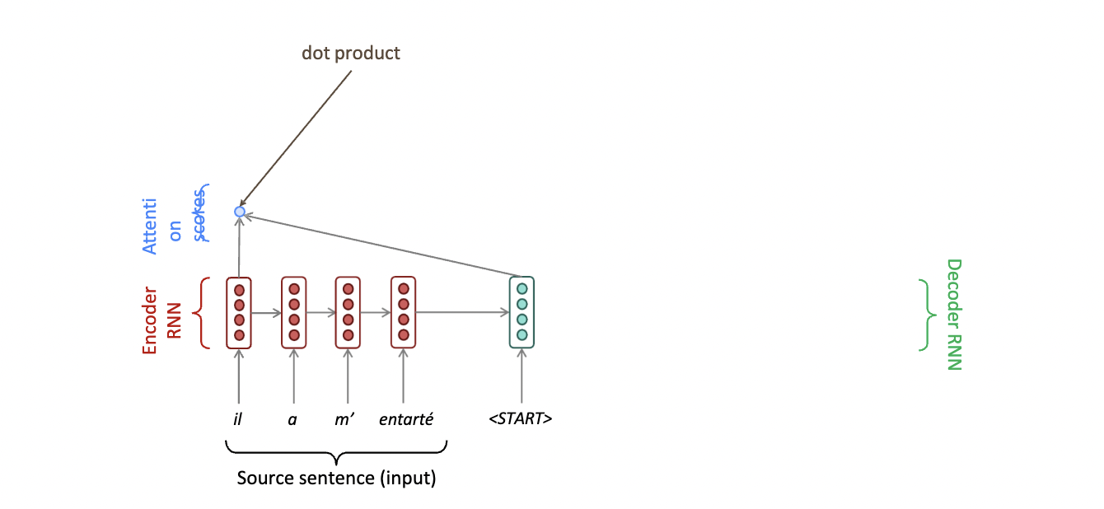
Seq to seq with Attention

Slide 14
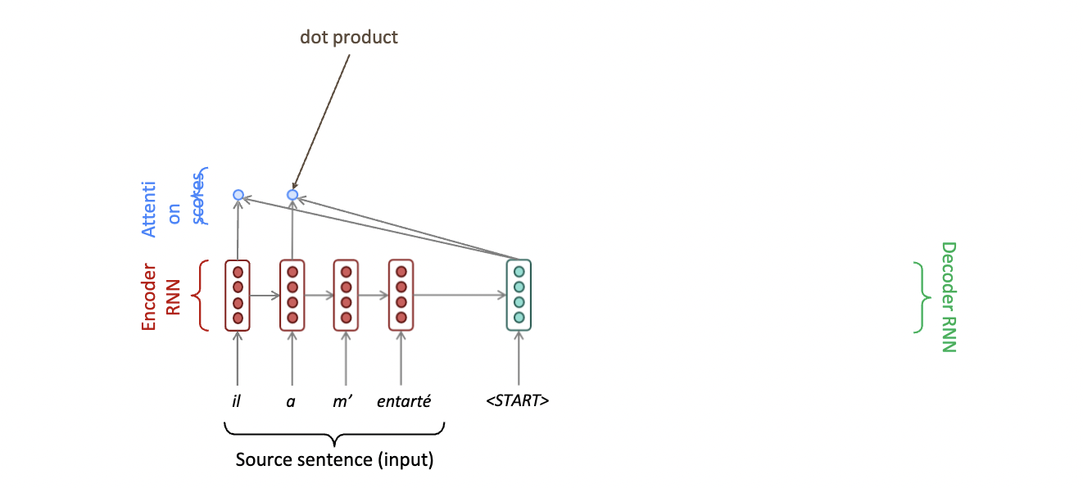
Seq to seq with Attention

Slide 15
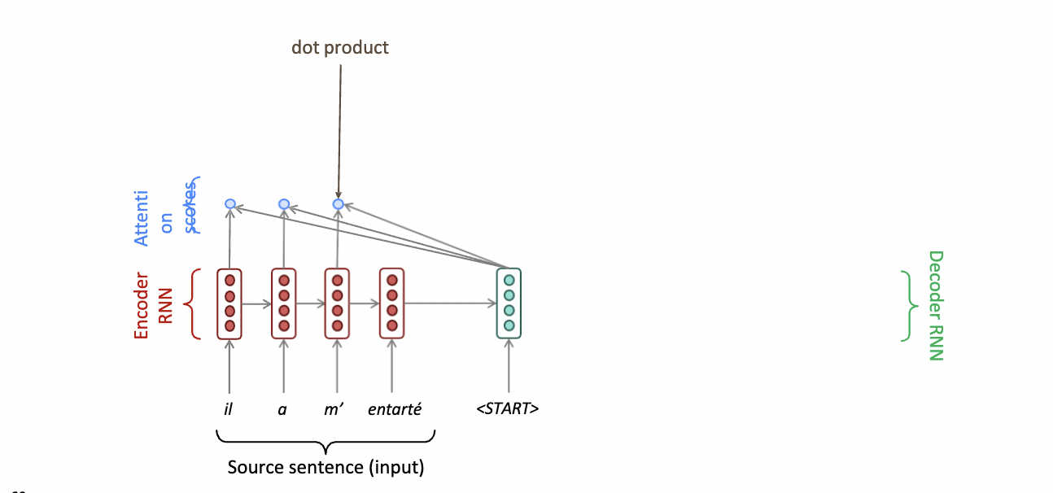
Seq to seq with Attention

Slide 16
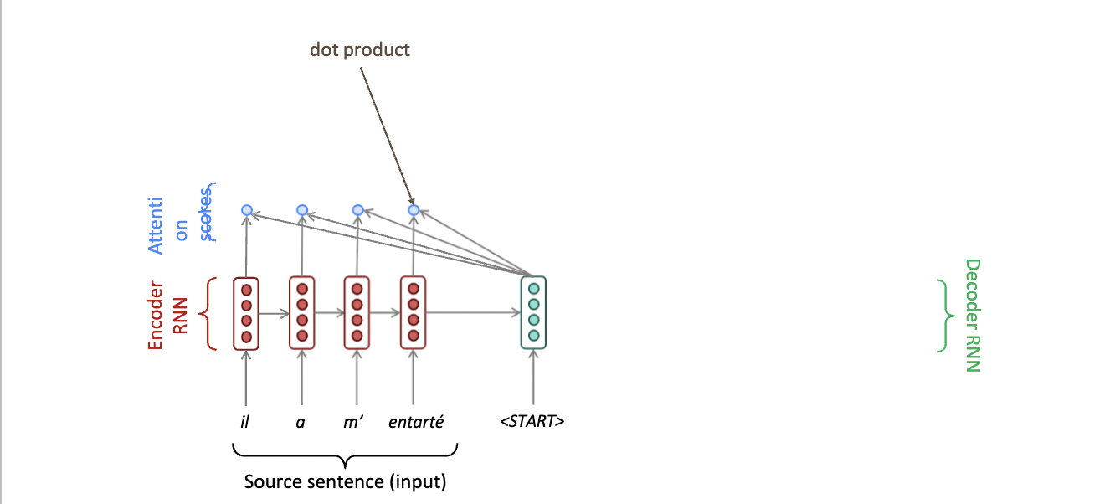
Seq to seq with Attention

Slide 17
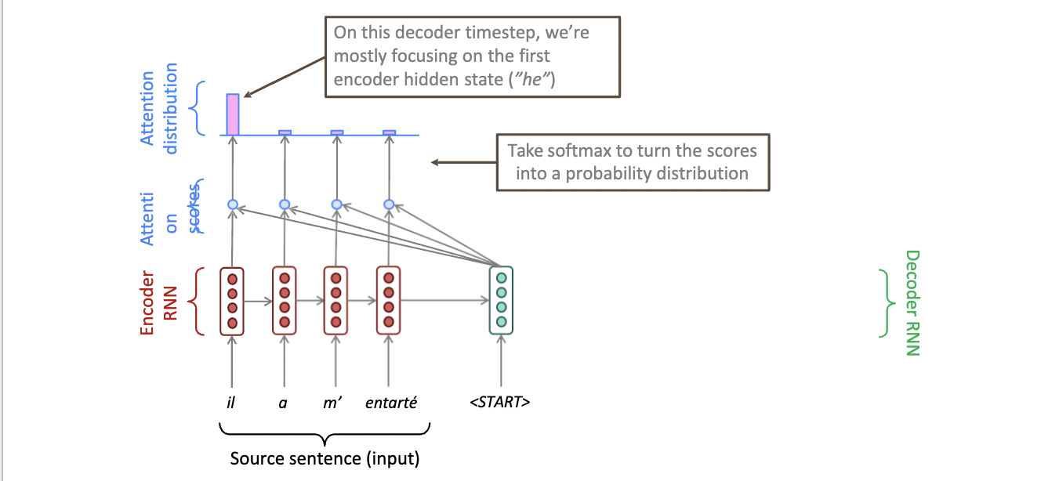
Seq to seq with Attention

Slide 18
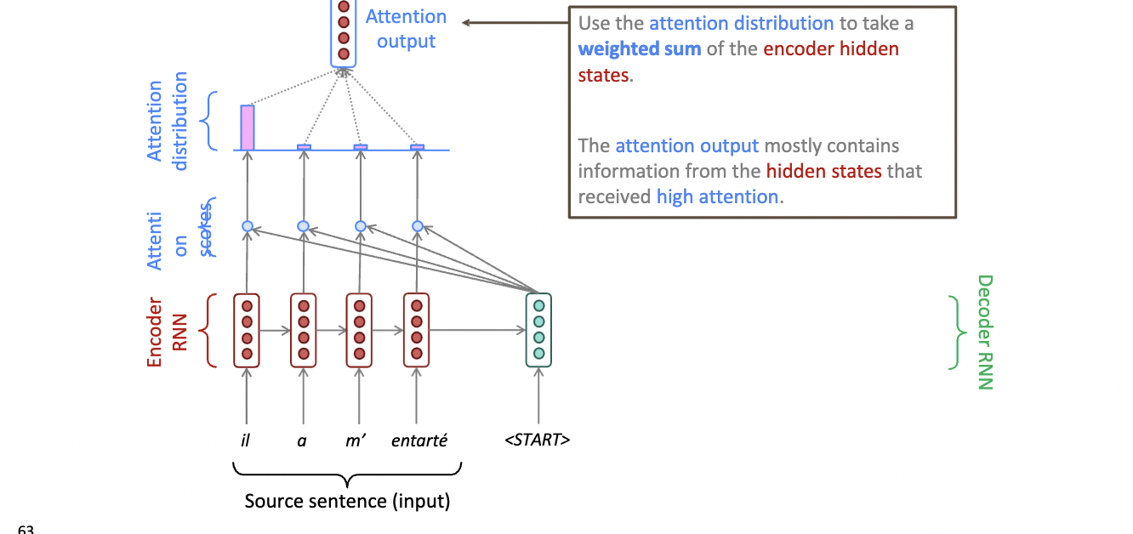
Seq to seq with Attention

Slide 19
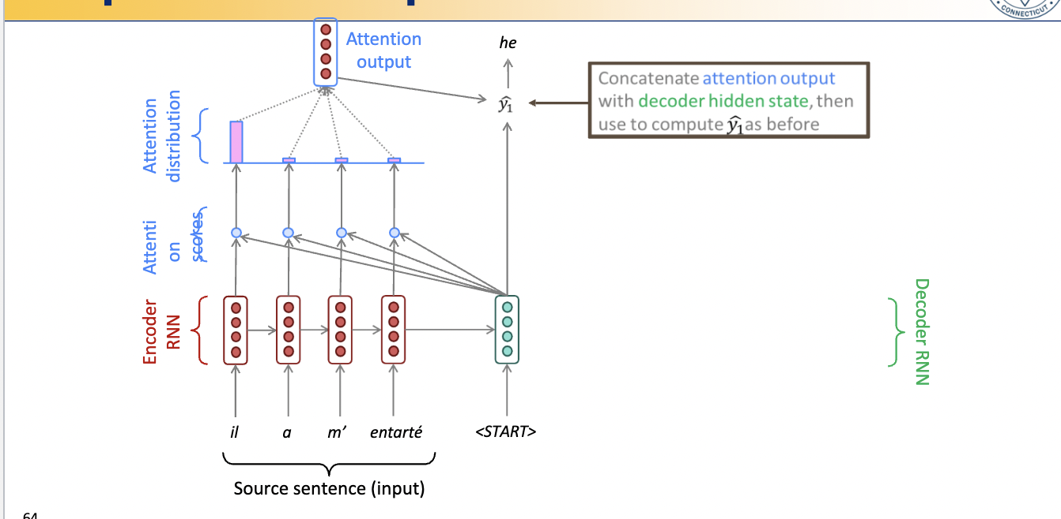
Seq to seq with Attention

Slide 20
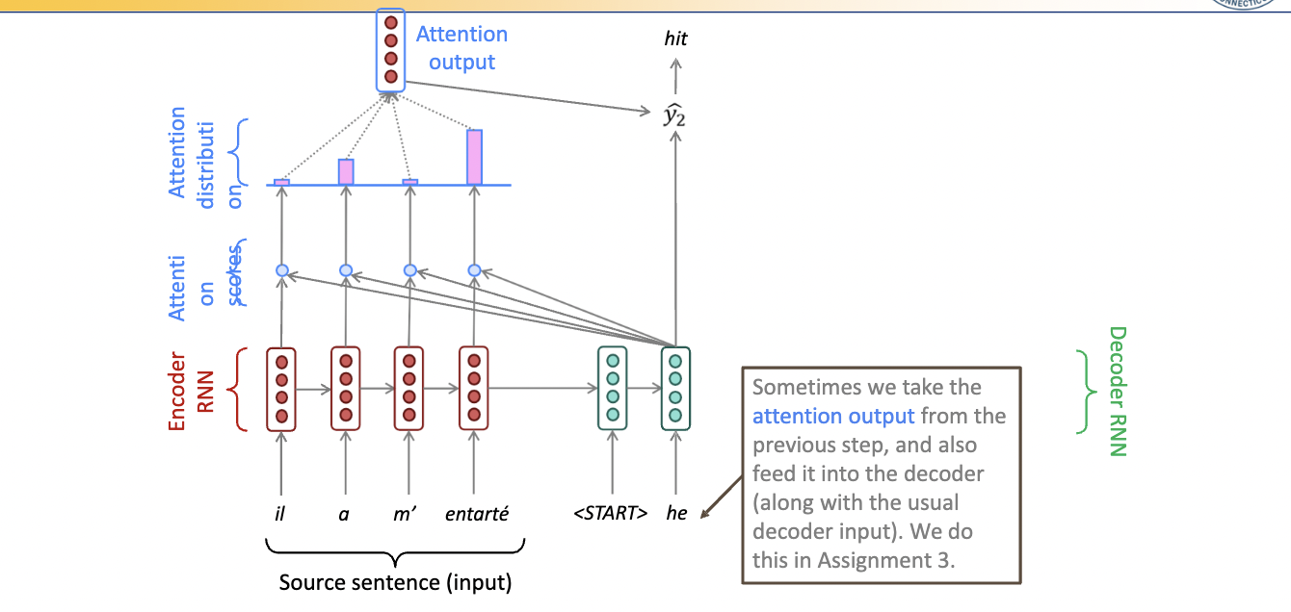
Seq to seq with Attention

Slide 21
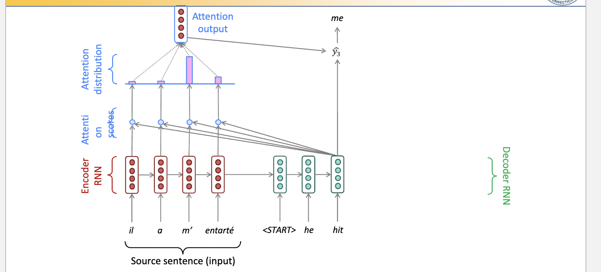
Seq to seq with Attention

Slide 22
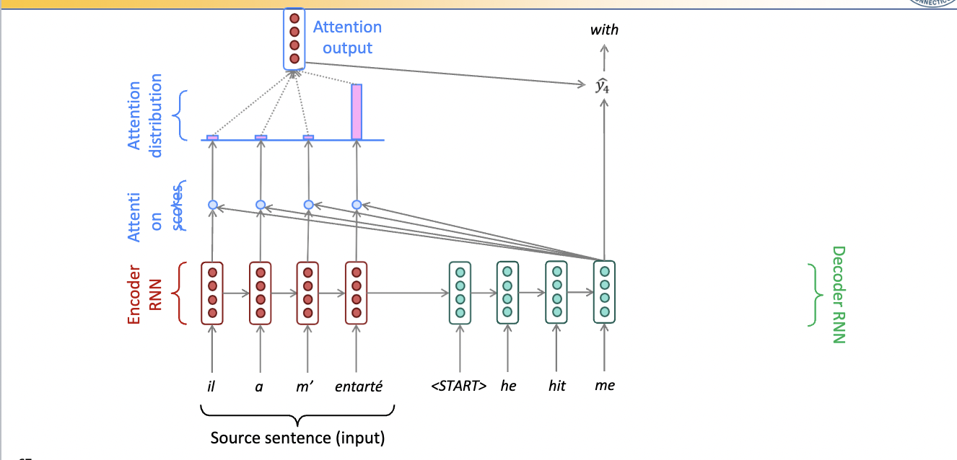
Seq to seq with Attention

Slide 23
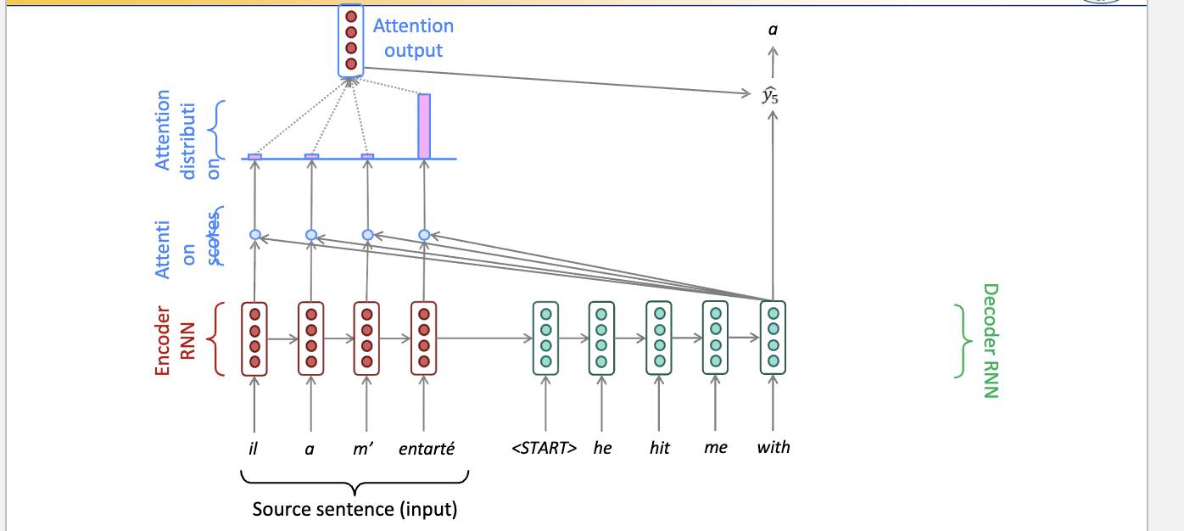
Seq to seq with Attention

Slide 24
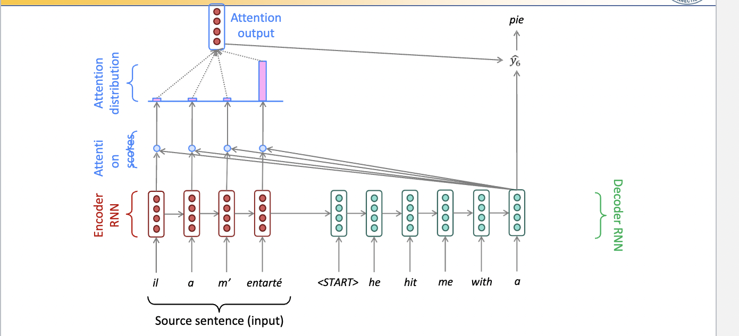
Seq to seq with Attention

Slide 25
Attention benefits:
1. Attention significantly improves NMT performance It’s very useful to allow decoder to focus on certain parts of the source
2. Attention provides more “human-like” model of the MT process You can look back at the source sentence while translating, rather than needing to remember it all
3. Attention solves the bottleneck problem Attention allows decoder to look directly at source; bypass bottleneck
4. Attention helps with the vanishing gradient problem Provides shortcut to faraway states
5. Attention provides some interpretability • By inspecting attention distribution, we see what the decoder was focusing on • We get (soft) alignment for free! • This is cool because we never explicitly trained an alignment system • The network just learned alignment by itself

Slide 26
Applications:
Beyond machine translation, attention has applications in speech recognition, image captioning, and any sequence-to-sequence task where context matters.
In summary, the attention mechanism allows neural networks to focus on different parts of an input sequence when generating an output sequence. It significantly enhances the quality and accuracy of sequence-to-sequence tasks by reducing the information bottleneck and ensuring that context is captured effectively.

Slide 27

Thank you.

